Slide 1
Java Class Methods

Slide 2
Java Class Methods
You learned from the Java Methods chapter that methods are declared within a class, and that they are used to perform certain actions:
Example
Create a method named myMethod() in Main:
public class Main {
static void myMethod() {
System.out.println("Hello World!");
}
}

Slide 3
Java Class Methods
myMethod() prints a text (the action), when it is called. To call a method, write the method's name followed by two parentheses () and a semicolon;
Example
Inside main, call myMethod():
public class Main {
static void myMethod() {
System.out.println("Hello World!");
}
public static void main(String[] args) {
myMethod();
}
}
// Outputs "Hello World!"

Slide 4
Static vs. Non-Static
You will often see Java programs that have either static or public attributes and methods.
In the example above, we created a static method, which means that it can be accessed without creating an object of the class, unlike public, which can only be accessed by objects:

Slide 5
Static vs. Non-Static
public class Main {
// Static method
static void myStaticMethod() {
System.out.println("Static methods can be called without creating objects");
}
// Public method
public void myPublicMethod() {
System.out.println("Public methods must be called by creating objects");
}
// Main method
public static void main(String[] args) {
myStaticMethod(); // Call the static method
// myPublicMethod(); This would compile an error
Main myObj = new Main(); // Create an object of Main
myObj.myPublicMethod(); // Call the public method on the object
}
}
Example
An example to demonstrate the differences between static and public methods:

Slide 6
Access Methods With an Object
// Create a Main class
public class Main {
// Create a fullThrottle() method
public void fullThrottle() {
System.out.println("The car is going as fast as it can!");
}
// Create a speed() method and add a parameter
public void speed(int maxSpeed) {
System.out.println("Max speed is: " + maxSpeed);
}
// Inside main, call the methods on the myCar object
public static void main(String[] args) {
Main myCar = new Main(); // Create a myCar object
myCar.fullThrottle(); // Call the fullThrottle() method
myCar.speed(200); // Call the speed() method
}
}
// The car is going as fast as it can!
// Max speed is: 200
Example
Create a Car object named myCar. Call the fullThrottle() and speed() methods on the myCar object, and run the program:

Slide 7
Example explained
1) We created a custom Main class with the class keyword.
2) We created the fullThrottle() and speed() methods in the Main class.
3) The fullThrottle() method and the speed() method will print out some text, when they are called.
4) The speed() method accepts an int parameter called maxSpeed - we will use this in 8).
5) In order to use the Main class and its methods, we need to create an object of the Main Class.
6) Then, go to the main() method, which you know by now is a built-in Java method that runs your program (any code inside main is executed).
7) By using the new keyword we created an object with the name myCar.
8) Then, we call the fullThrottle() and speed() methods on the myCar object, and run the program using the name of the object (myCar), followed by a dot (.), followed by the name of the method (fullThrottle(); and speed(200);). Notice that we add an int parameter of 200 inside the speed() method.

Slide 8
Using Multiple Classes
it is a good practice to create an object of a class and access it in another class.
Remember that the name of the java file should match the class name. In this example, we have created two files in the same directory:
Main.java
Second.java

Slide 9
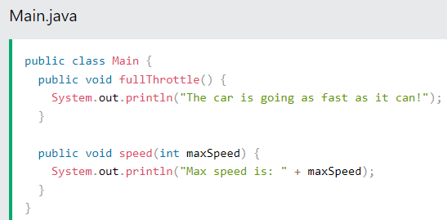
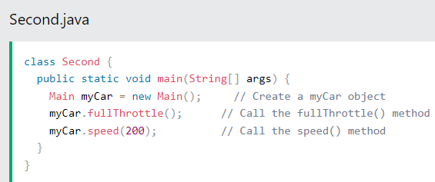
Using Multiple Classes

